Slide 1
AI+BD ML Lab. Day 4
June 14th, 2021
Convolutional Neural Network (CNN)
YoungIn Kim <youngkim21@postech.edu>

Slide 2
Today’s Goals
Kaggle competition (for test)
“CNN”
Create CNN model with CAM
Learn CIFAR-10 data with your model
Watch your CAM
4. Early stopping

Slide 3
Goals
Understanding basic components of CNN
Composing a CNN model and test it with CIFAR-10 dataset
Watching Class Activation Map using CNN

Slide 4
Kaggle competition
Let’s get the highest score!

Slide 5

Kaggle
Link
https://www.kaggle.com/t/c5ba45a8b05443f3b1a62c50cb9188a6

Slide 6
Kaggle
Sample code
https://git.io/kaggle-sample
need to change “root” & “save_root”

Slide 7
Backgrounds
For your information & reminding

Slide 8
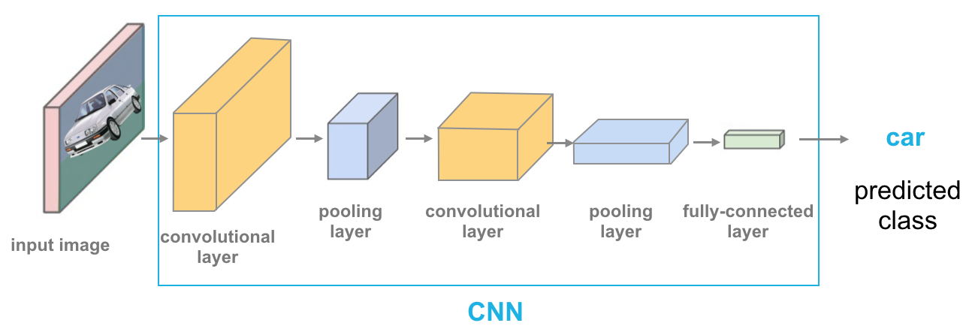
Convolutional Neural Network
A good network for image

Slide 9
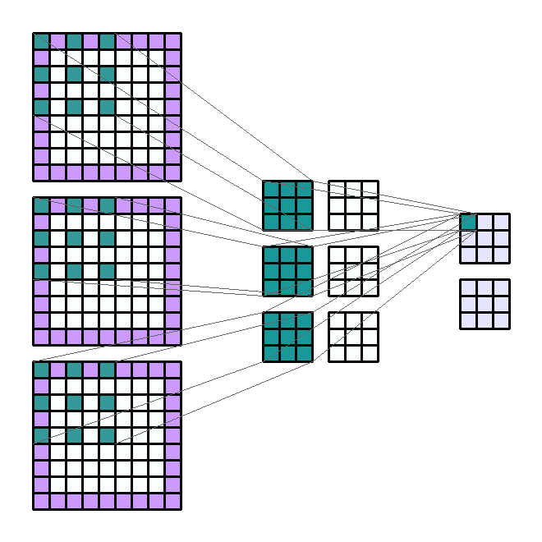
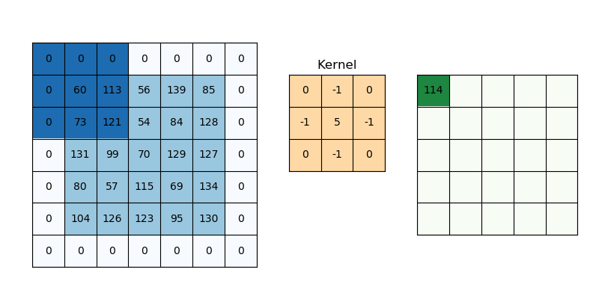
Components of CNN
Convolution Operation (Conv2d)

Slide 10
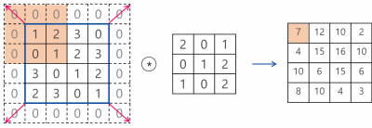
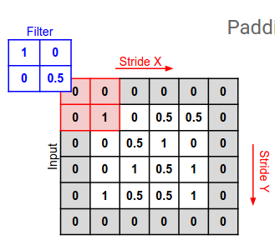
Components of CNN
Convolution Operation (Conv2d) – Stride, Padding

Slide 11

Components of CNN
Max-pooling (MaxPool2d)

Slide 12
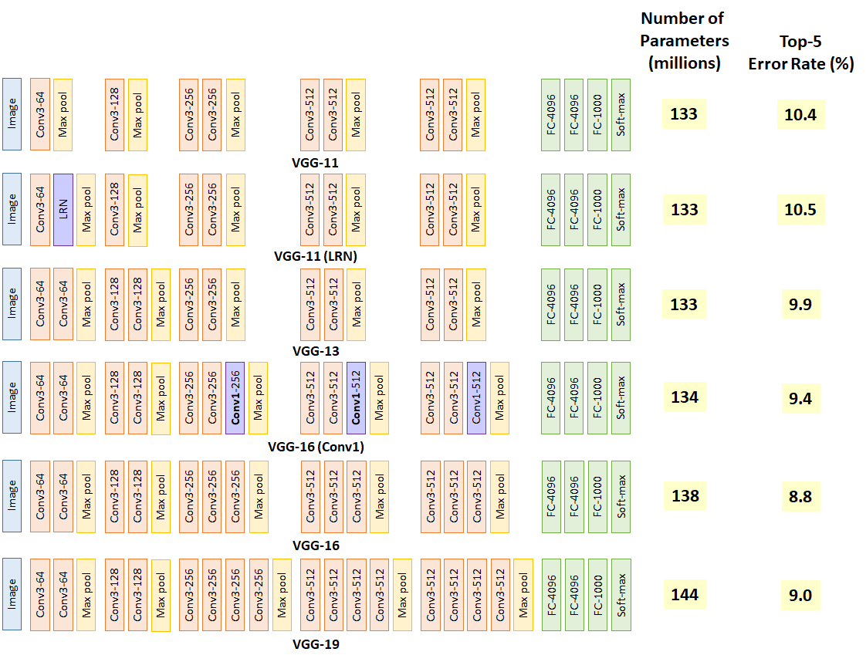

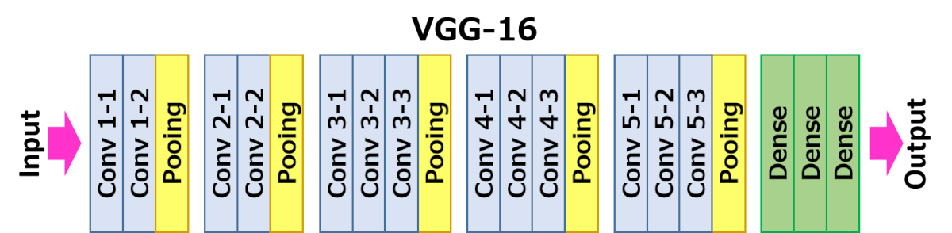
Famous CNNs
VGG11-19

Slide 13
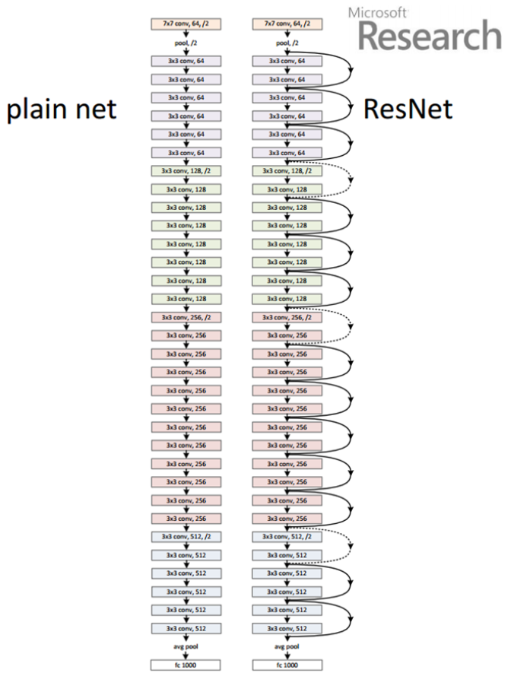
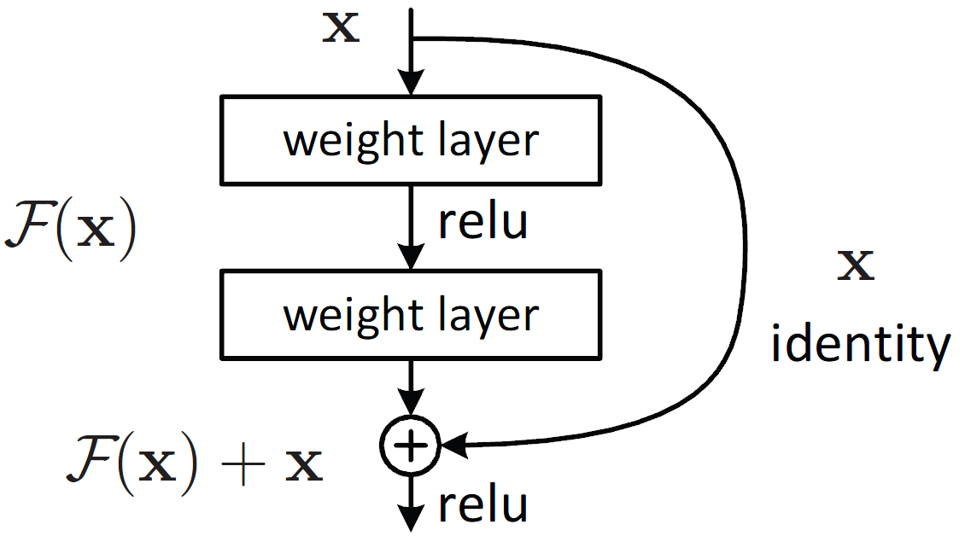
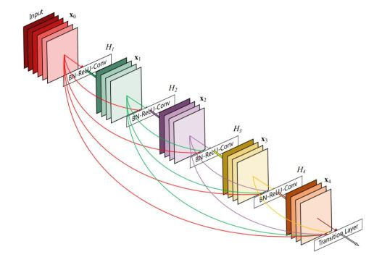
Famous CNNs
ResNet

Slide 14
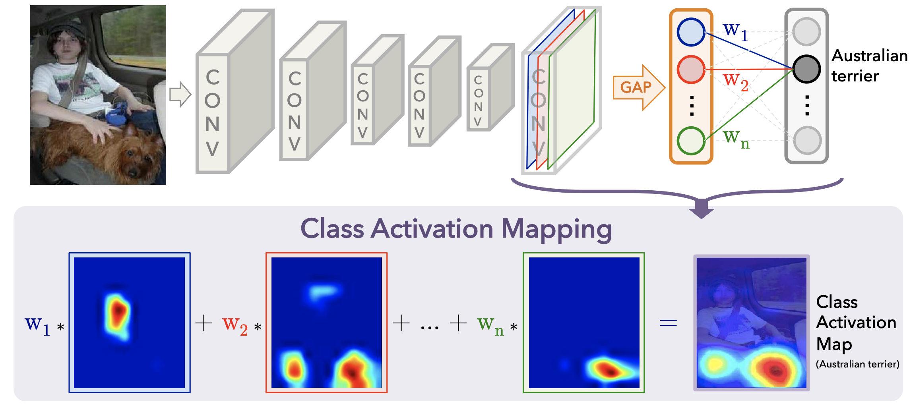
Class Activation Map

Slide 15
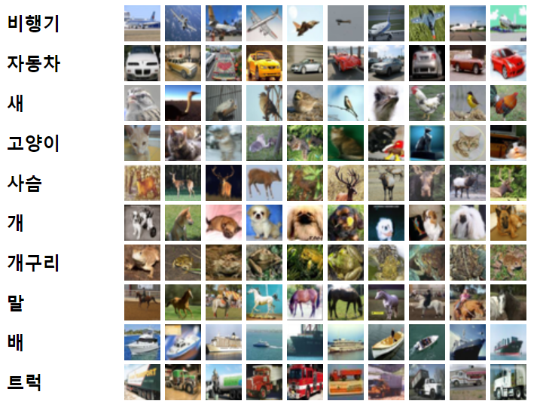
CIFAR 10 Dataset
10 classification dataset by Canadian Institute For Advanced Research
32X32 RGB image
50000 training data pairs
10000 test data pairs
Today we will upscale this 32x32 image to 224x224 RGB image

Slide 16
It’s coding time
Let’s fill the I.P.Y.N.B

Slide 17
Preparation
Base .ipynb :
https://git.io/aibd-cnn-student
Required Python Packages :
matplotlib numpy scikit-learn scikit-image
torch torchvision torchsummary

Slide 18
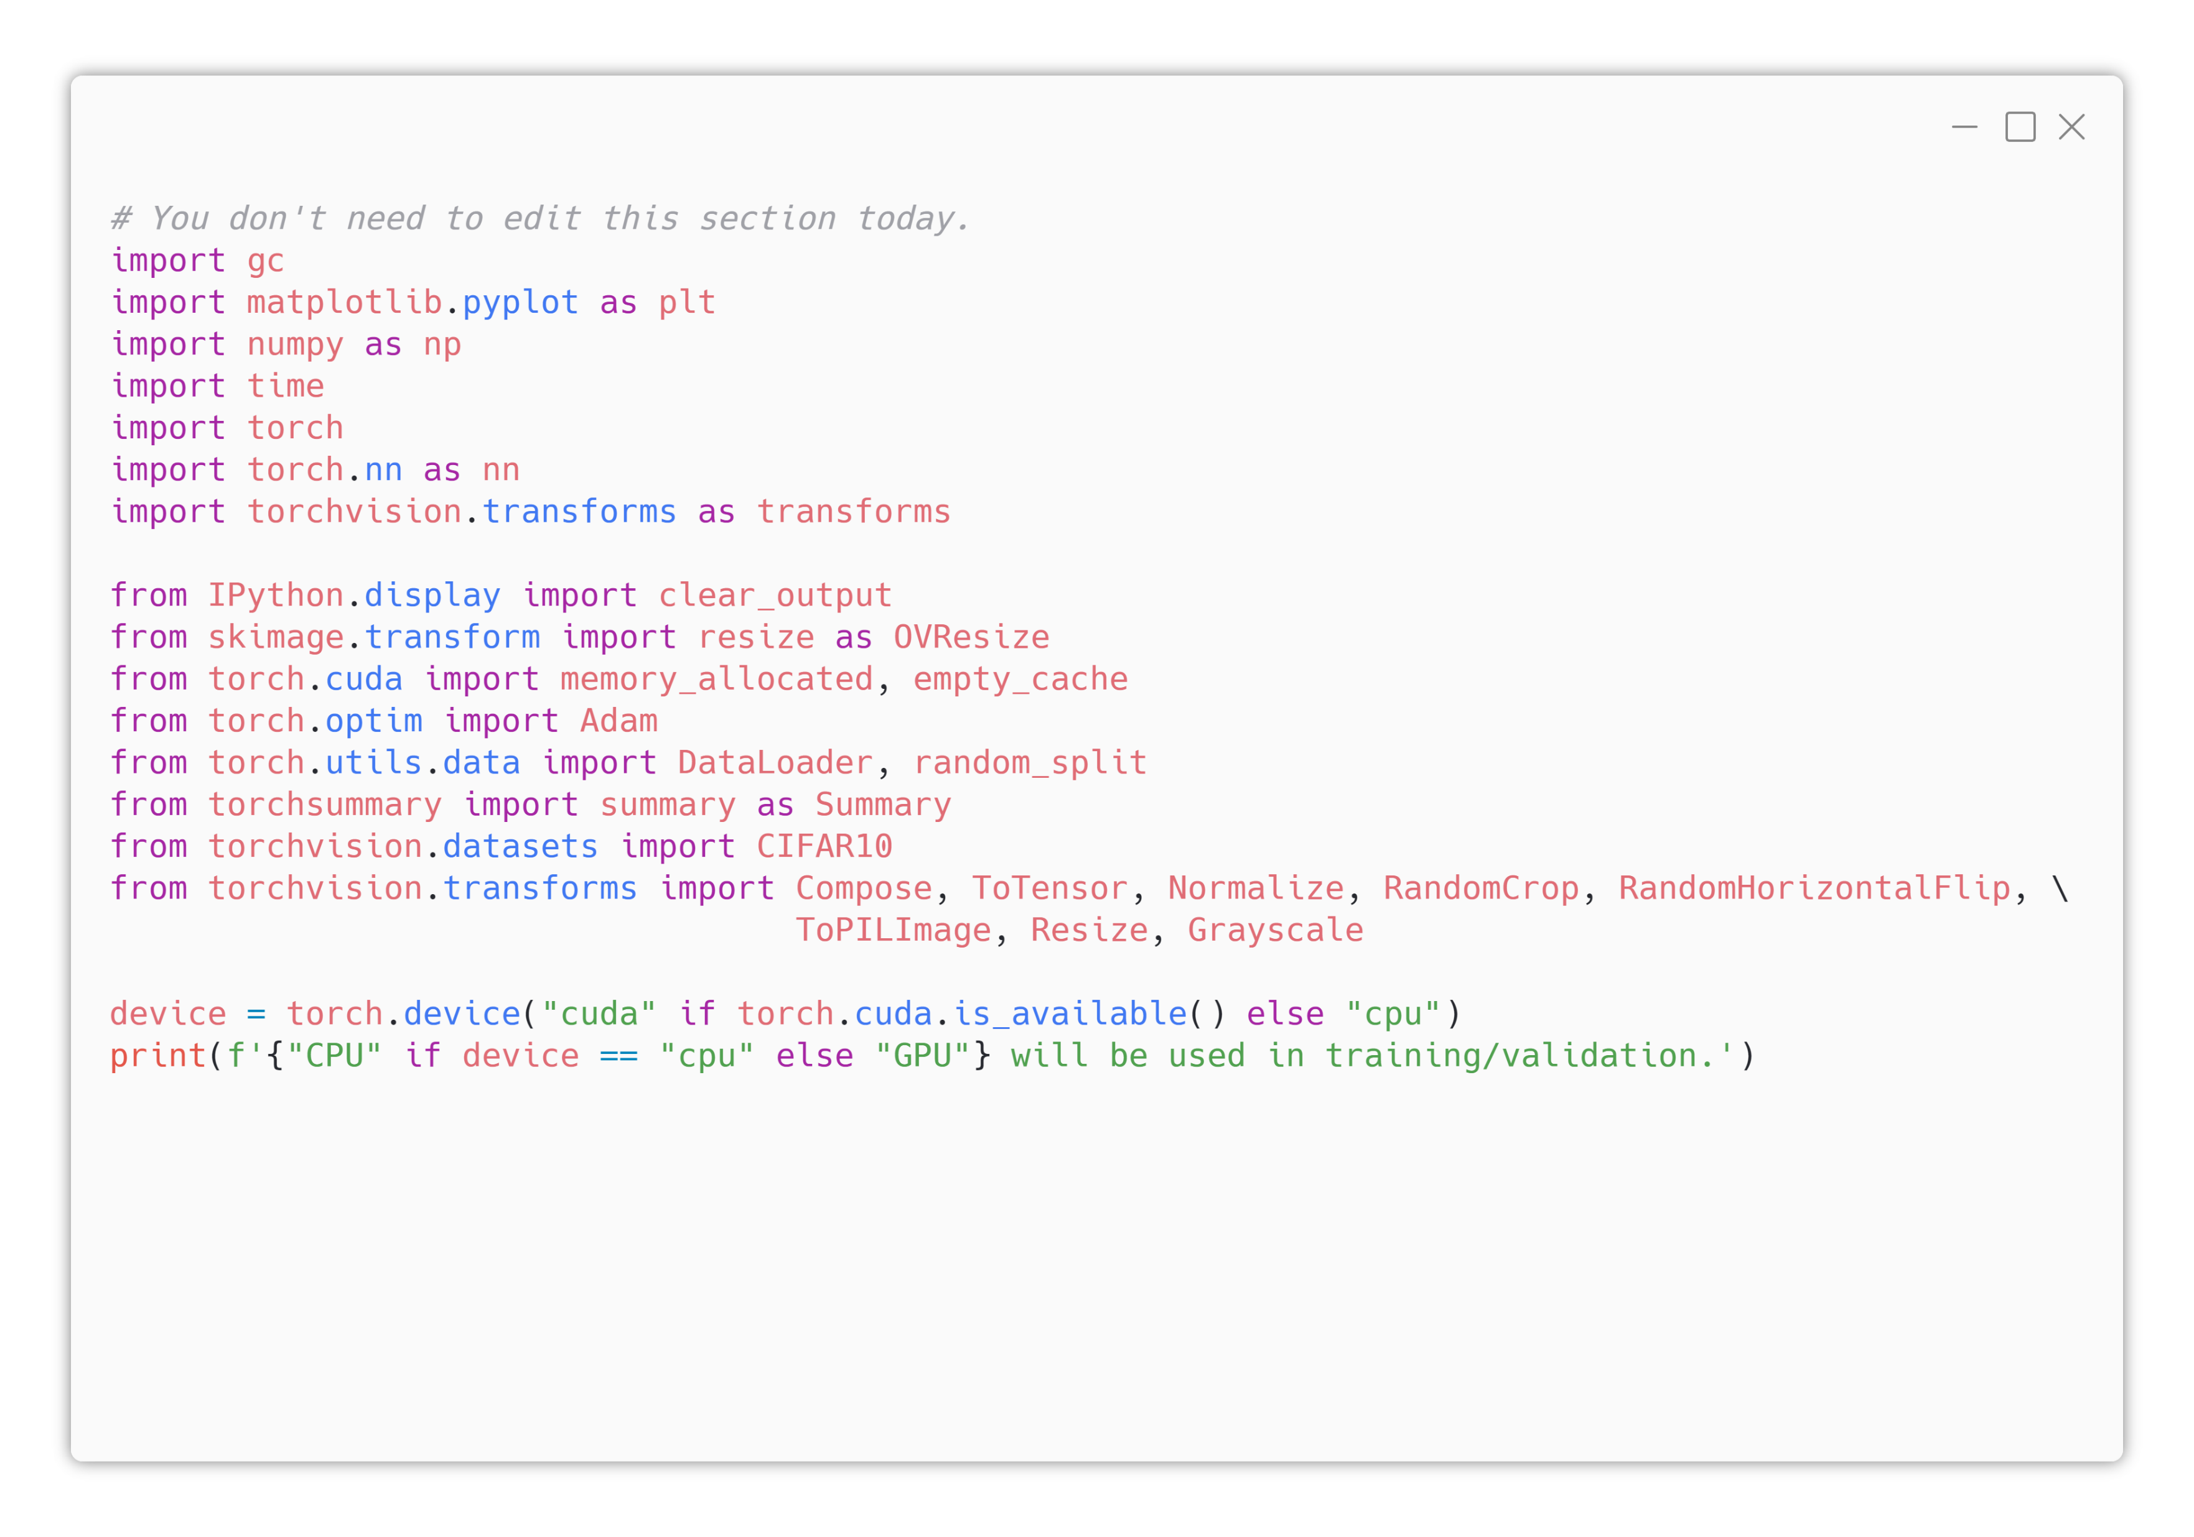

1. Lib & Dev Prep.
Already filled by TA
Today, we will use a lot of preprocessing techniques (torchvision.transforms)

Slide 19
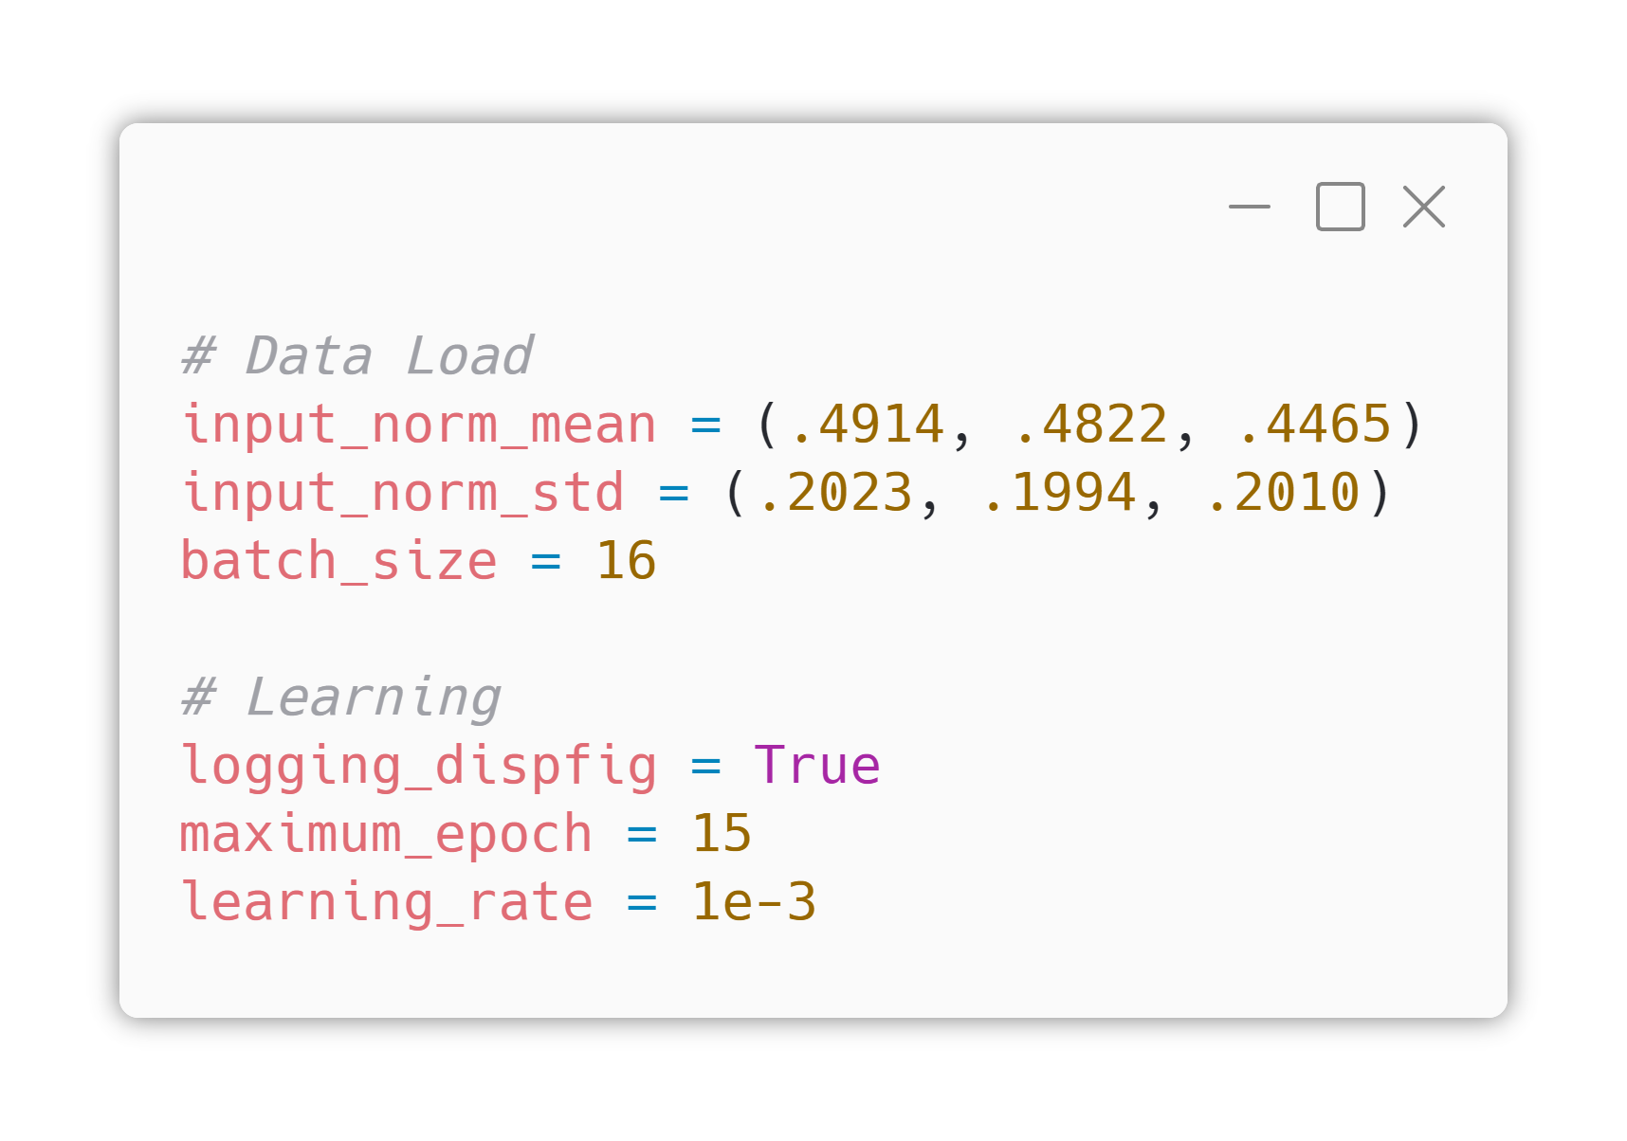
2. Hyperparams
No Model-related Hyper Parameters Today!
input_norm_mean and input_norm_std normalizes R/G/B channel to make various images be looked similarly.
Those values are fit to CIFAR-10, calculated based on computer vision theory.
Today’s batch size is small (16), because of the CUDA memory problem.

Slide 20
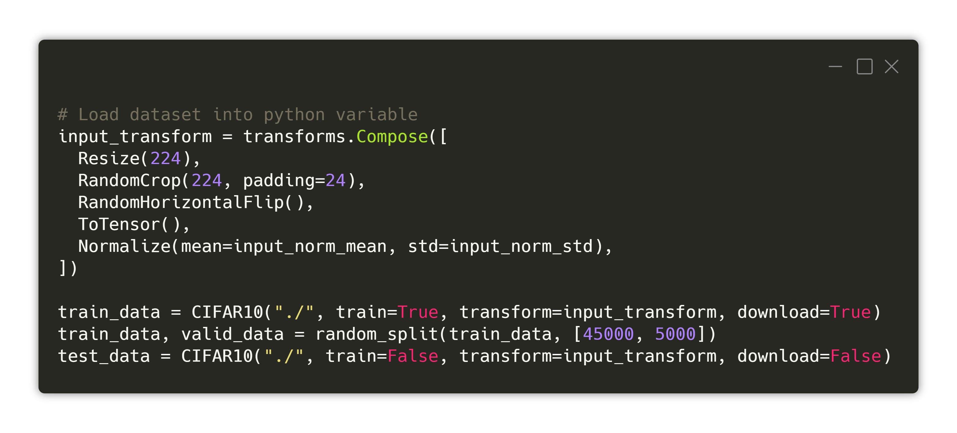
2. Hyperparams
No Model-related Hyper Parameters Today!
Today, we will use CNN model based on VGG11. VGG11 receives images with size of 224x224, so in same way, we will convert our 32x32 CIFAR10 images into 224x224 images. (“Resize(224)”)
Then we will apply data augmentation technique for more generic model. (“RandomCrop”, “RandomHorizontalFlip”)
Then we will convert our data onto Tensor and will apply RGB normalizing as I mentioned in previous slide.

Slide 21
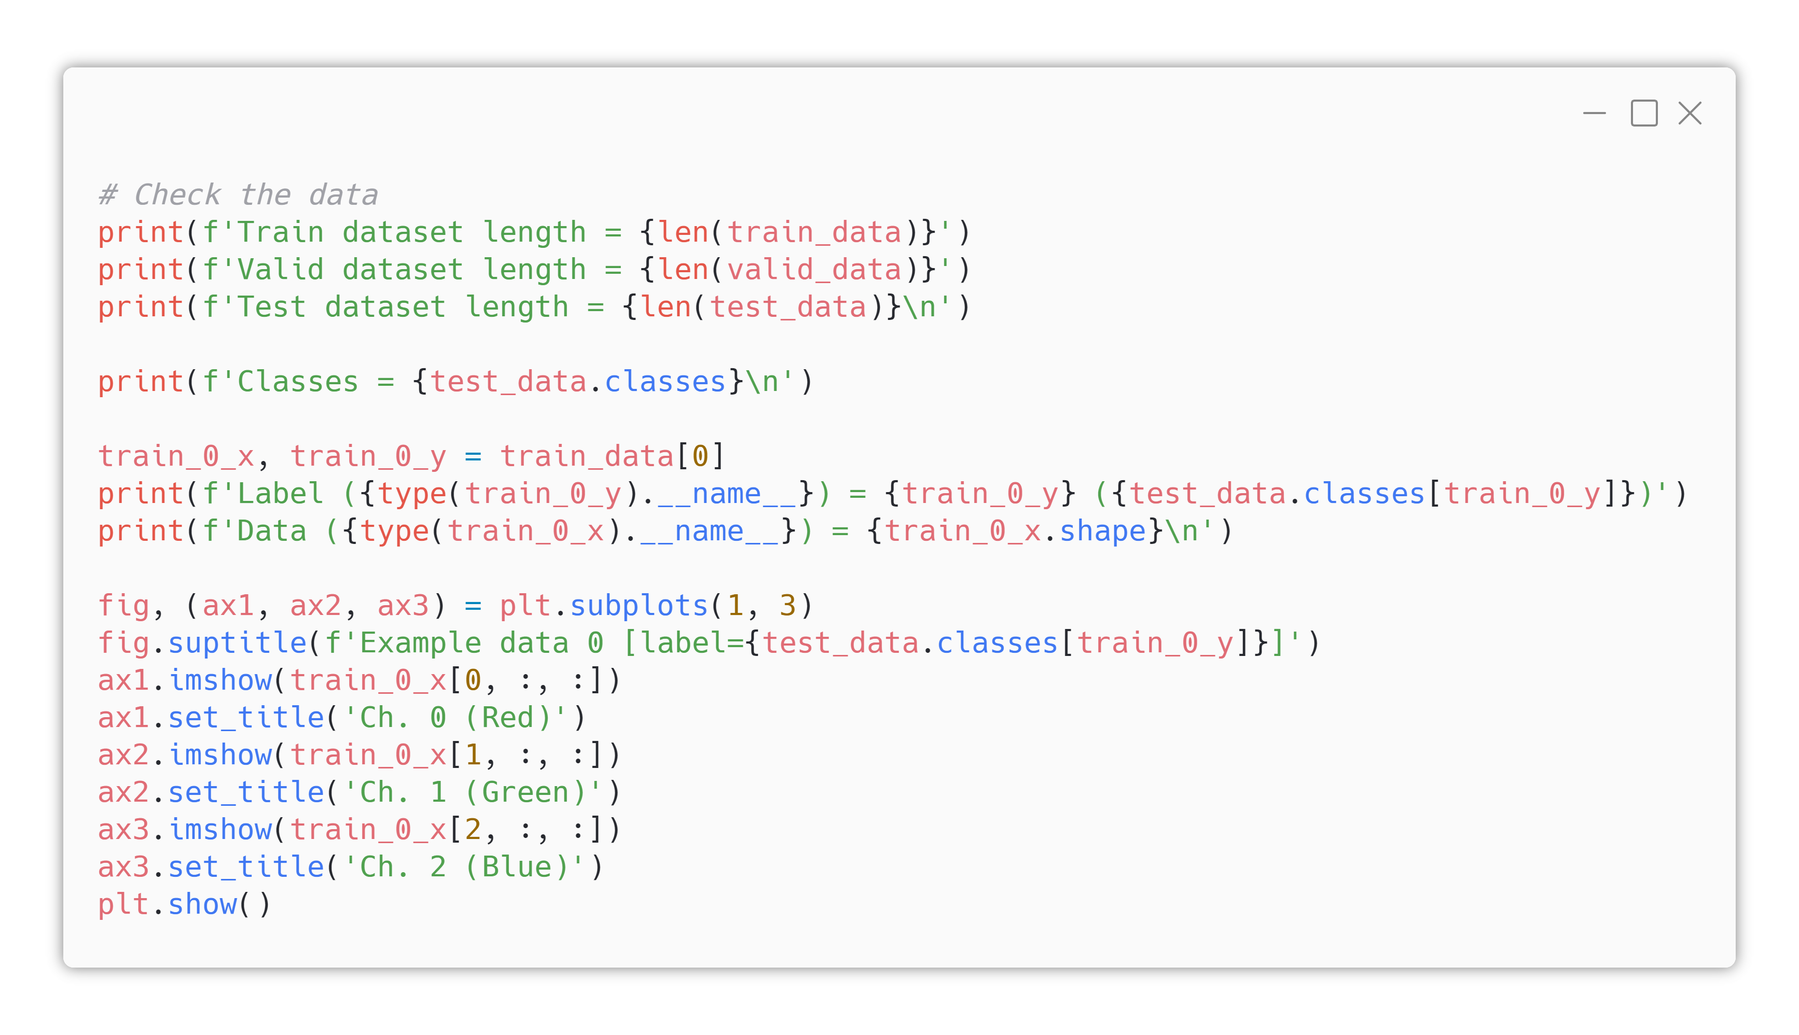
3. Data Load/Prepp.
Dataset loading
These code will show you R/G/B channel of an example image, in separated.

Slide 22
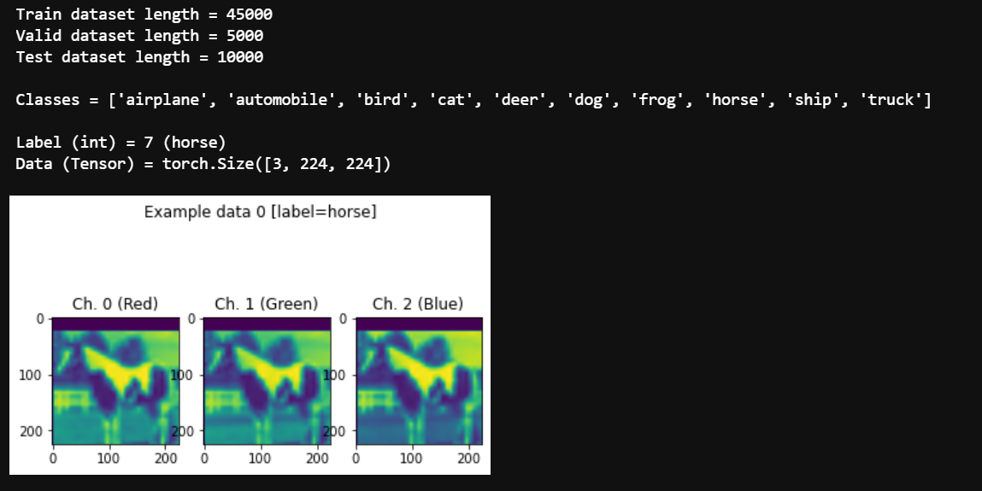
3. Data Load/Prepp.
Dataset loading
Expected Result
Look. As we applied RandomCrop, the upper part of the horse image is cropped! (empty section colored as purple).

Slide 23
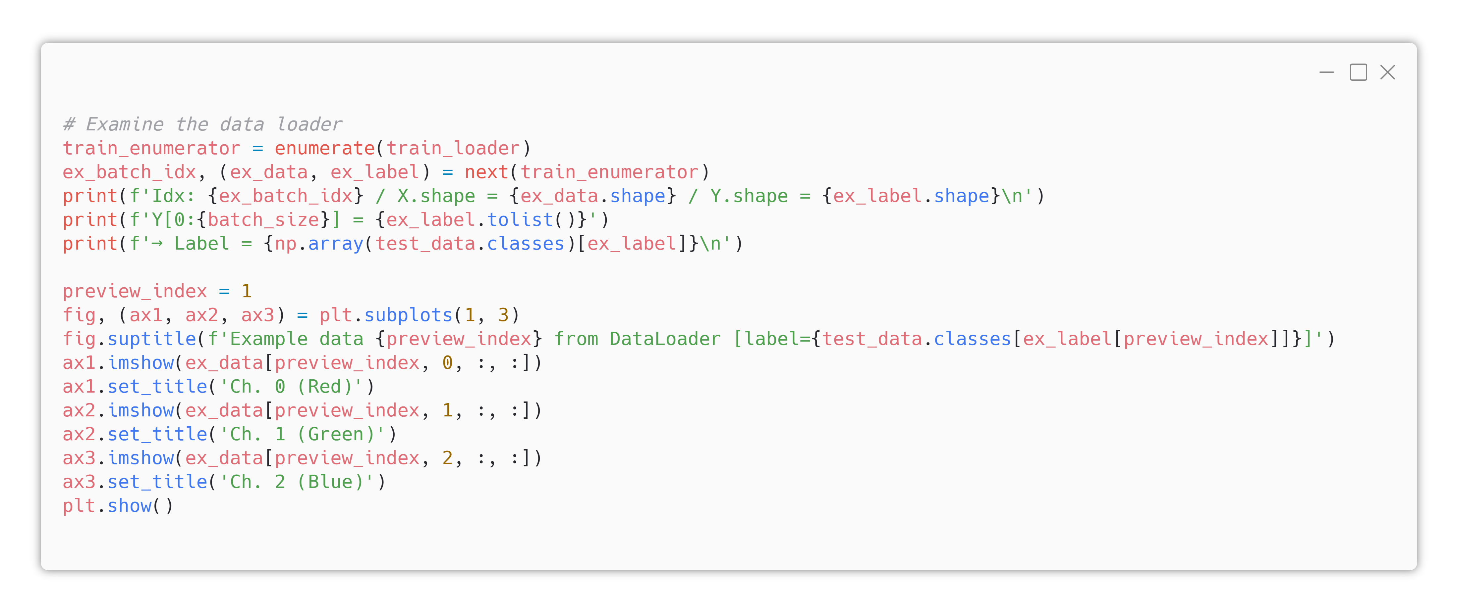
3. Data Load/Prepp.
DataLoader Wrapping

Slide 24
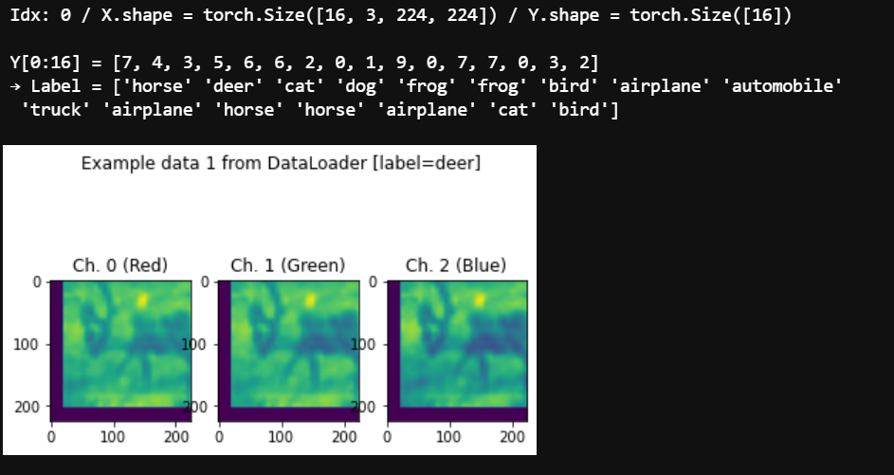
3. Data Load/Prepp.
DataLoader Wrapping
Expected Result

Slide 25
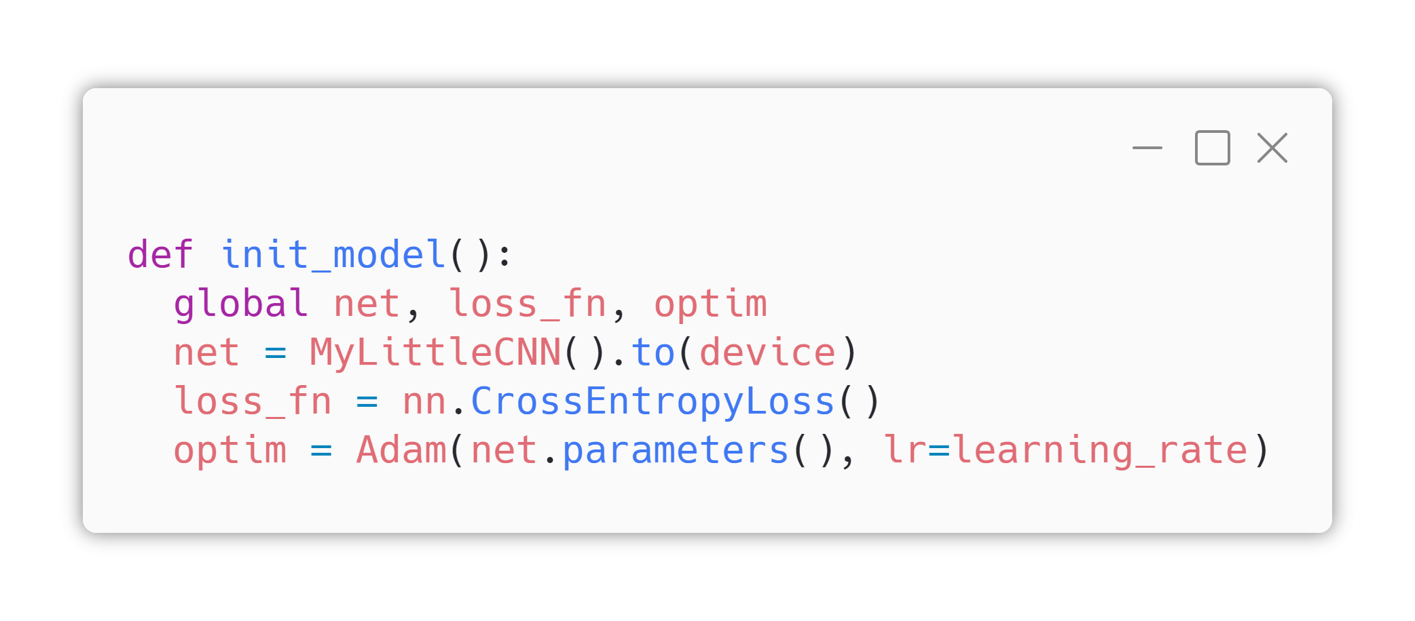
4. Fn. Definitions
Model Definition
As we did yesterday, we will define our model in class structure.
Loss function is still crossentropy
Today, we will use “Adam” optimizer, which is widely used these days instead of SGD.

Slide 26
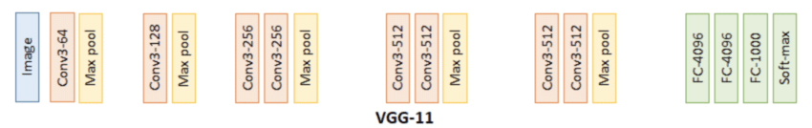
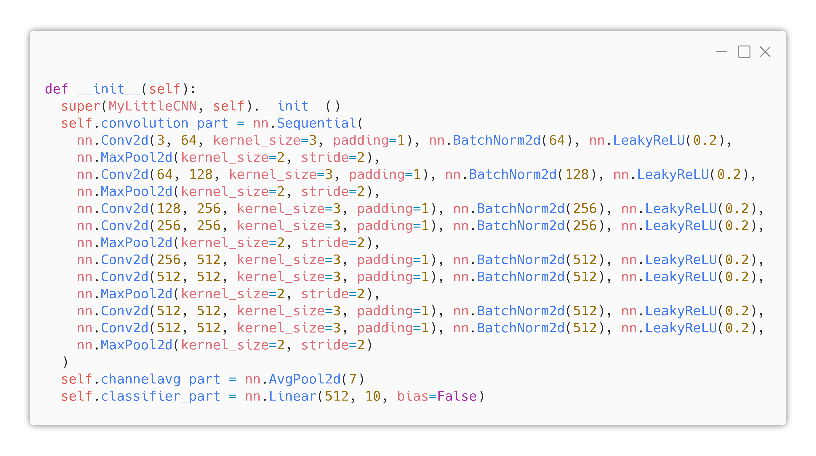
4. Fn. Definitions
Model Definition
Compare top-left VGG11 image and above code.

Slide 27
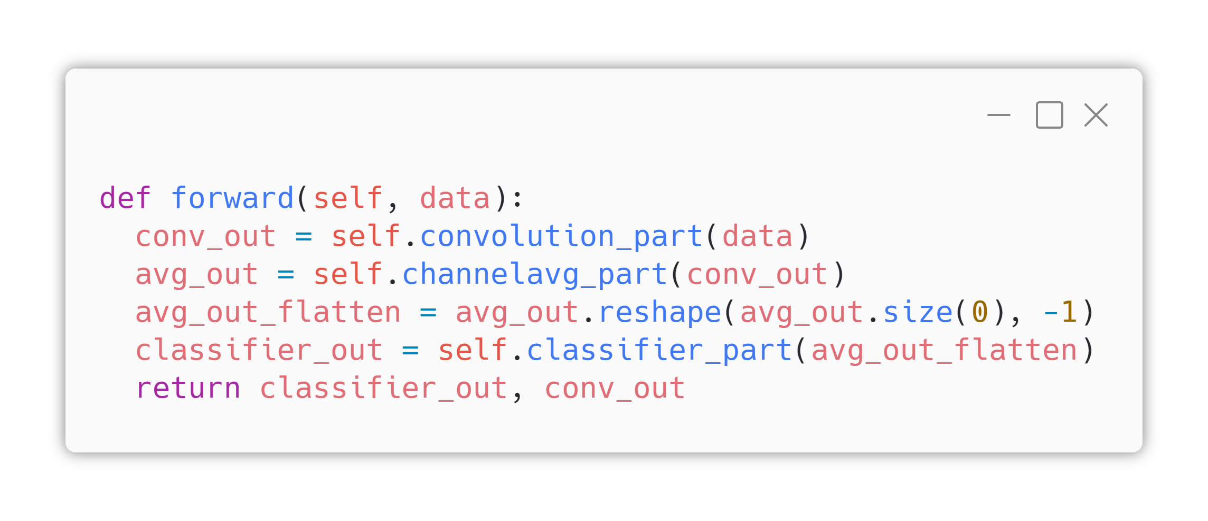
4. Fn. Definitions
Model Definition
Forward function only connects “convolution_part -> channelavg_part -> classifier_part”, with reshaping output of channelavg part and taking away convolution part output for purpose of drawing CAM.

Slide 28
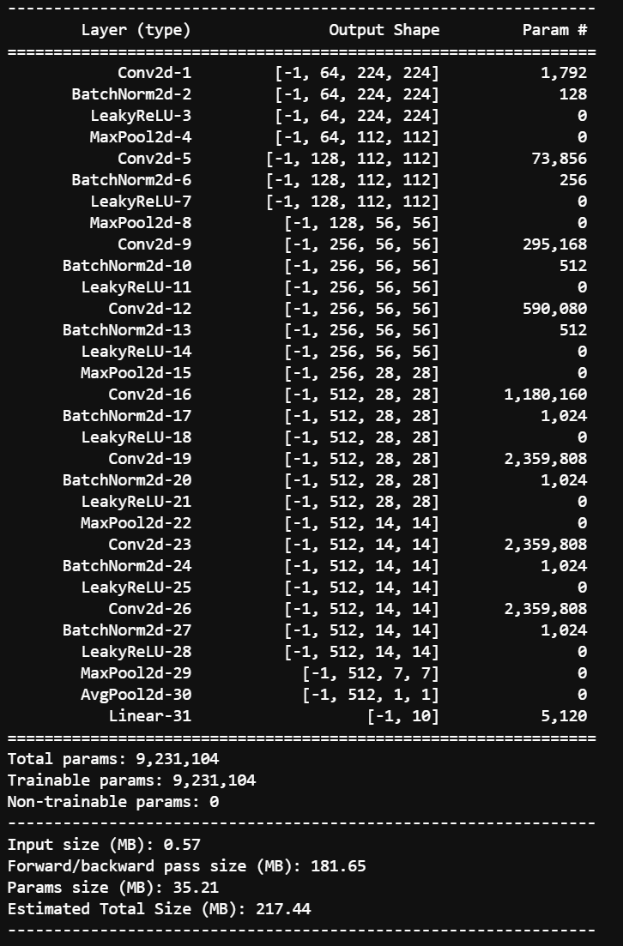
4. Fn. Definitions
Model Definition
Expected Result
Compare left TorchSummary output and below VGG 11 block diagram.

Slide 29
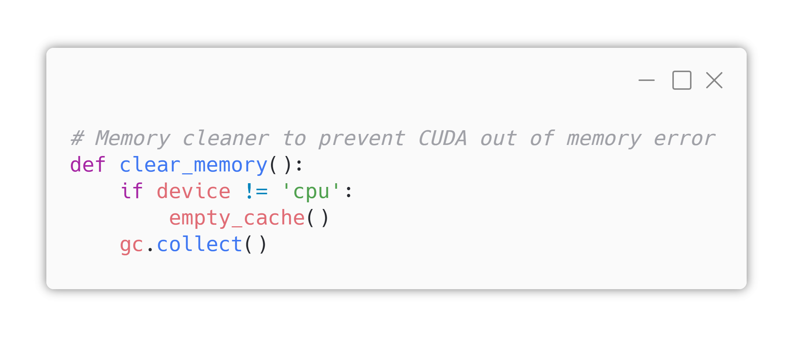
4. Fn. Definitions
GPU Memory Cleaner
Today’s model is based on VGG and VGG is very memory-intensive model. So we’re defining GPU/CPU useless cache memory cleaning function.

Slide 30
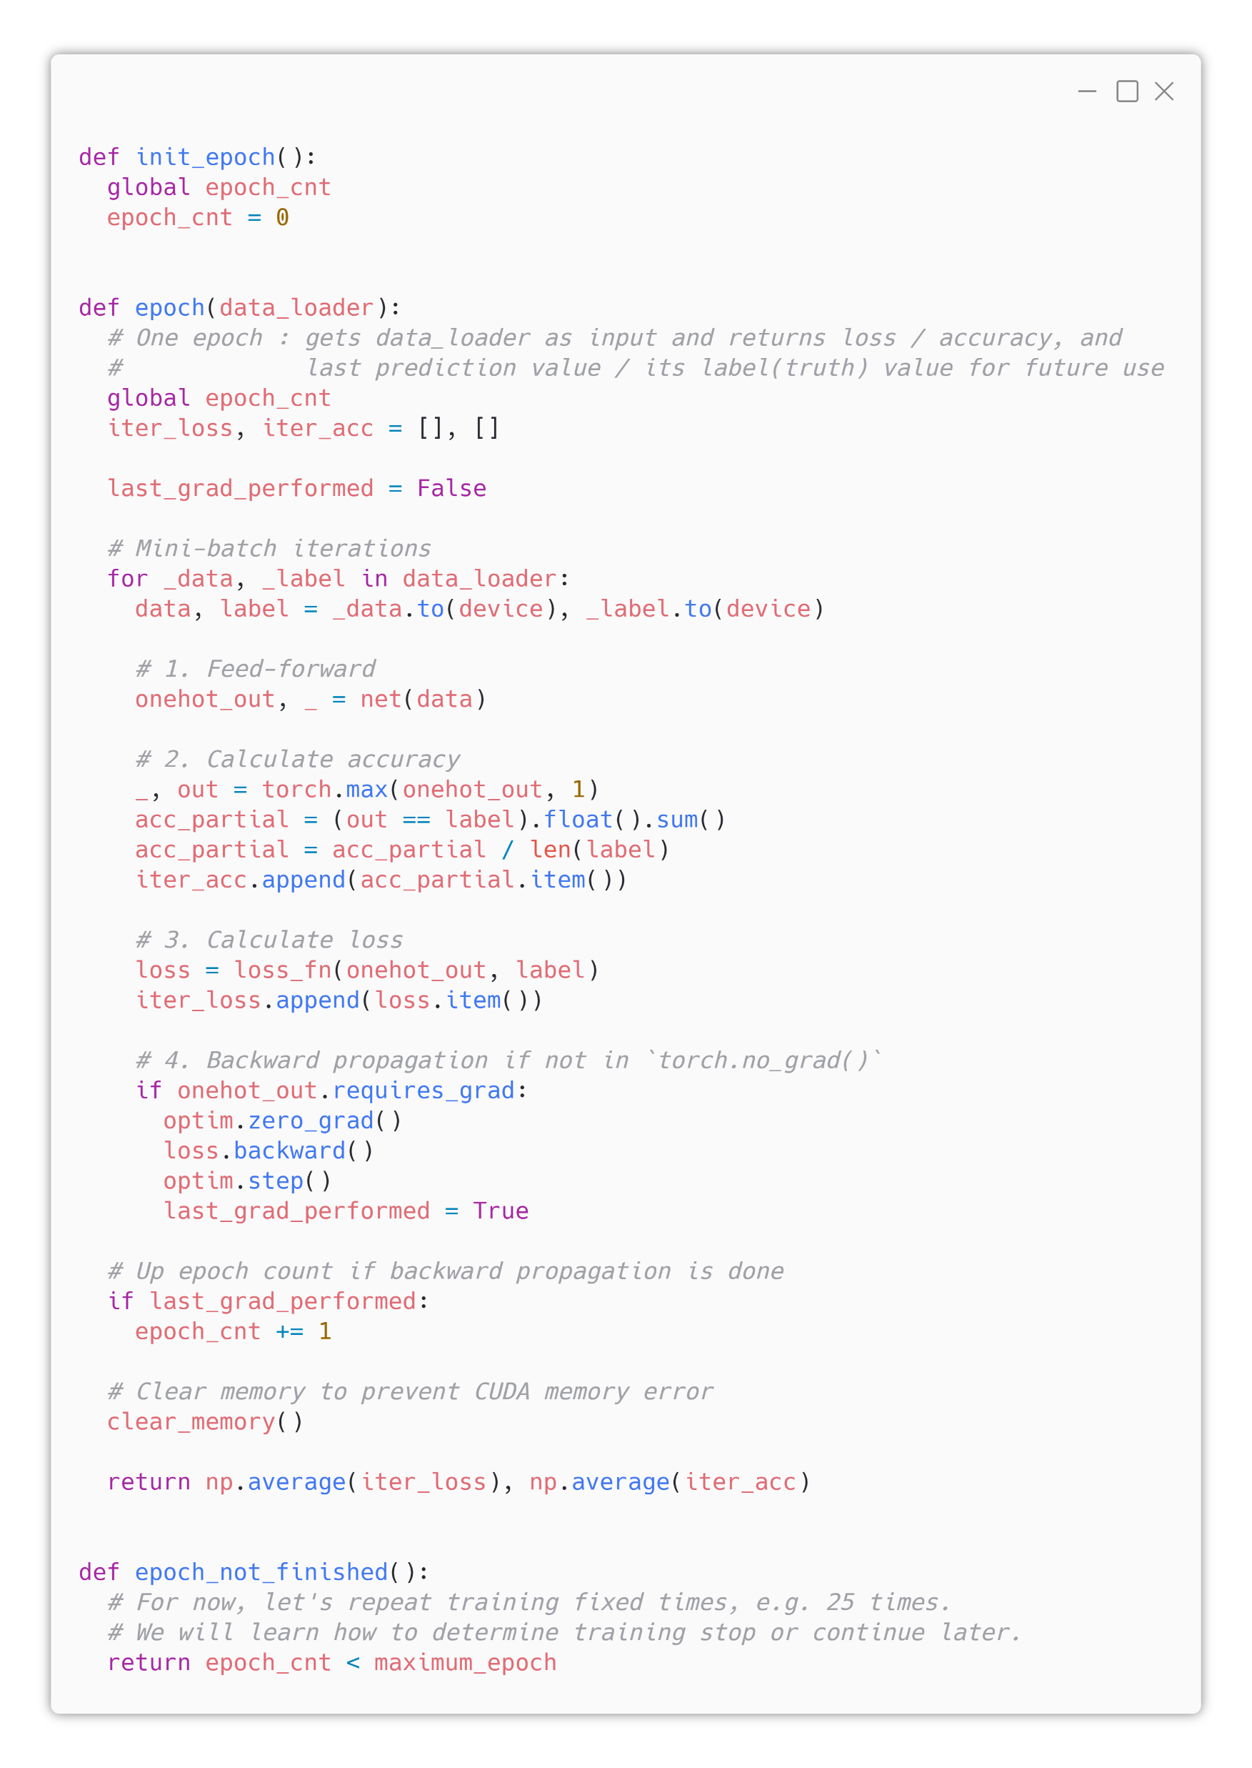
4. Fn. Definitions
Epoch Function
Filled by TA
Same as yesterday.

Slide 31
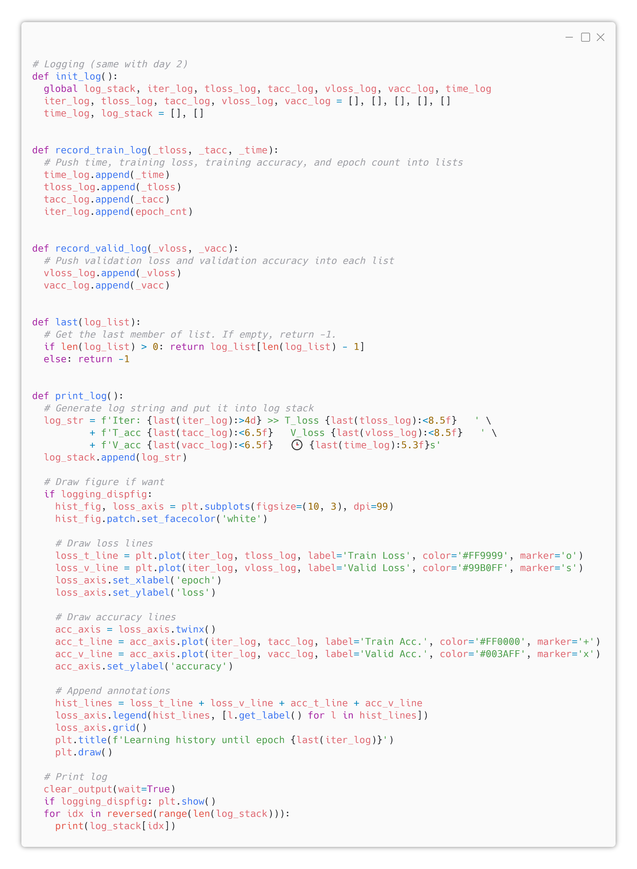
4. Fn. Definitions
Logging Function
Filled by TA
Same as yesterday.

Slide 32
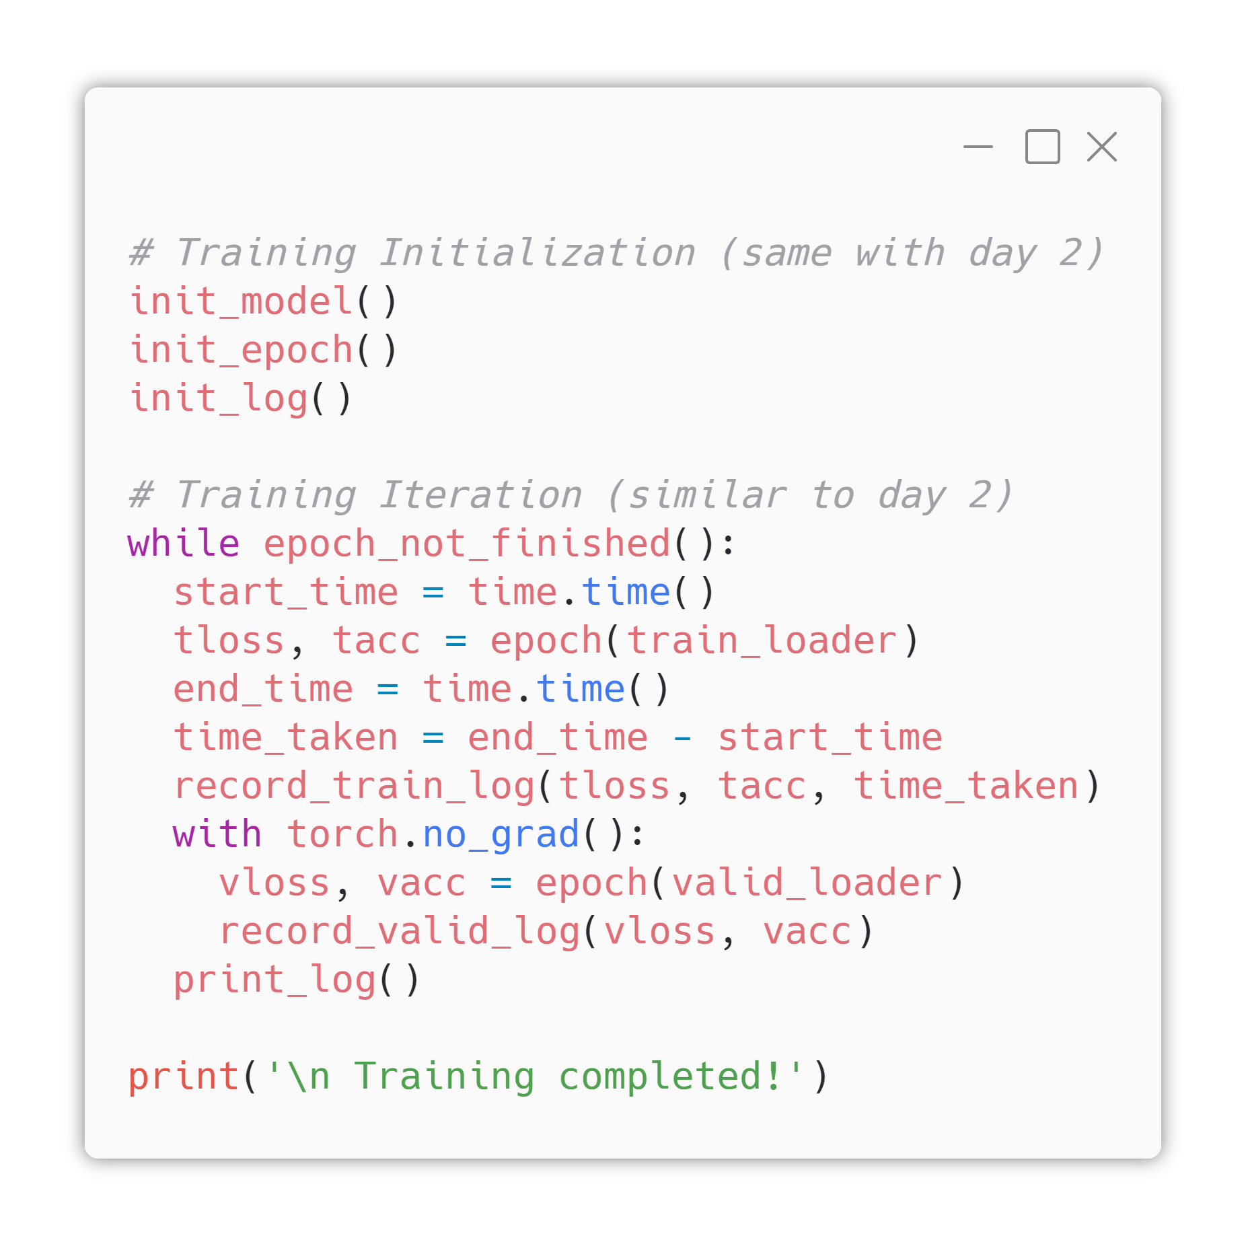
5. Training Iter.
Yeah
Filled by TA
Same as yesterday.

Slide 33
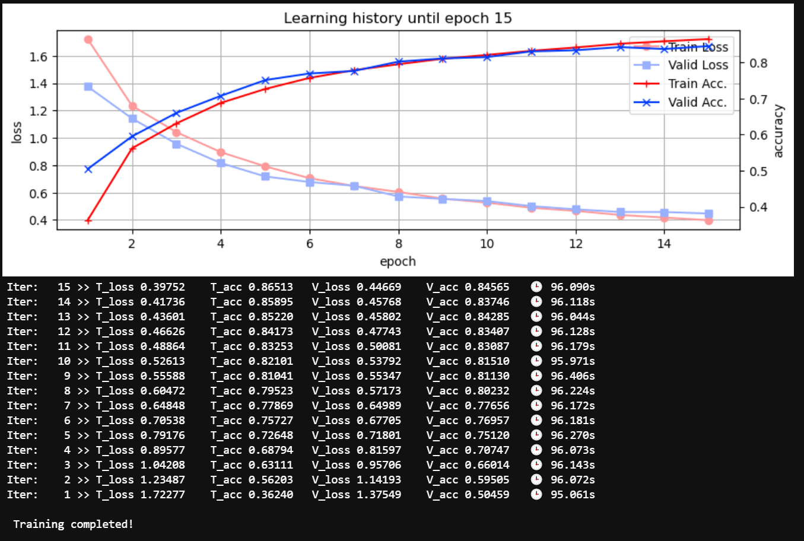
5. Training Iter.
Yeah
Beautiful graph.
Expected
Result

Slide 34
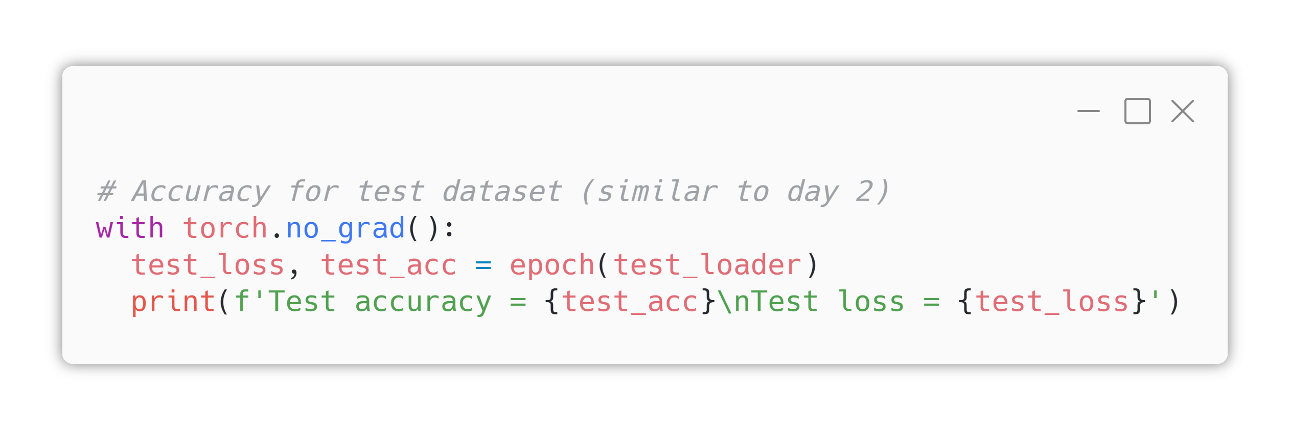
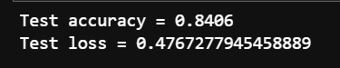
6. Result Analysis
Accuracy
Filled by TA
Expected Result

Slide 35
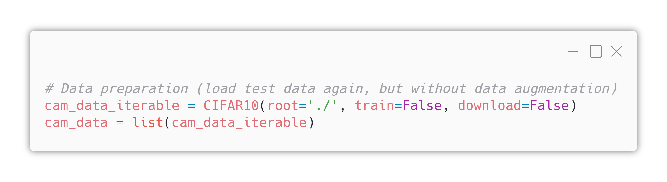
6. Result Analysis
Class Activation Map
Now we’re trying to draw class activation map (CAM).
Because we want draw the original picture and overlay CAM on it, first load image data without any transformations (first line).
Then make it as a python list (second line)

Slide 36
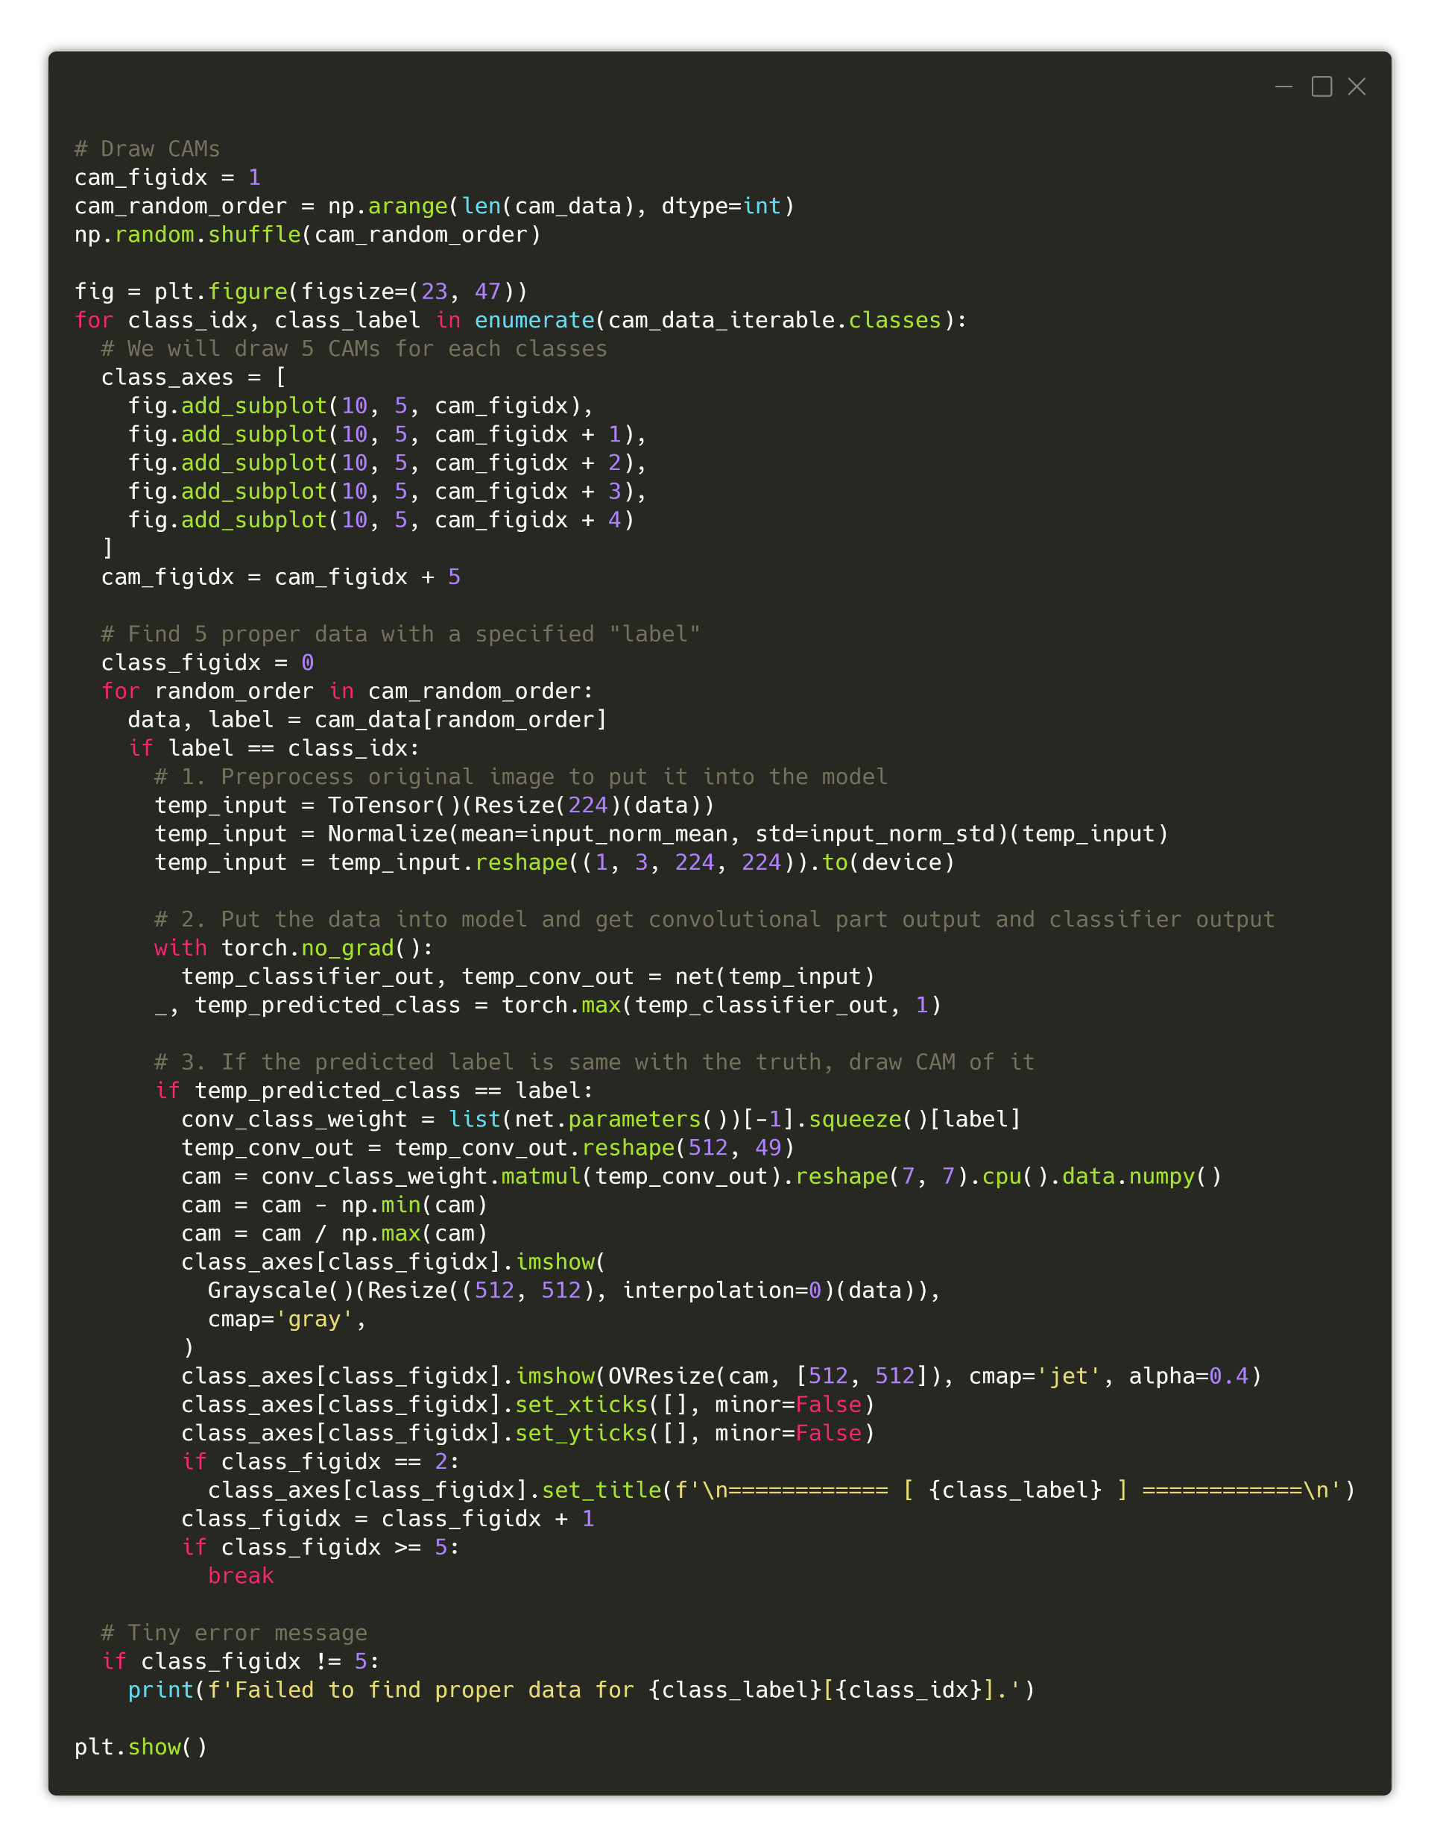
6. Result Analysis
Class Activation Map
For the full picture of “Drawing CAM” code,
Look at here : https://i.imgur.com/tlhLuS7.png
Also check for “#comments” the description.

Slide 37
6. Result Analysis
Class Activation Map
Look at here : https://laf.gg/aibd-cam

Slide 38
6. Result Analysis
Class Activation Map
Look at here : https://laf.gg/aibd-cam

Slide 39
6. Result Analysis
Class Activation Map
Look at here : https://laf.gg/aibd-cam

Slide 40
6. Result Analysis
Class Activation Map
Look at here : https://laf.gg/aibd-cam

Slide 41
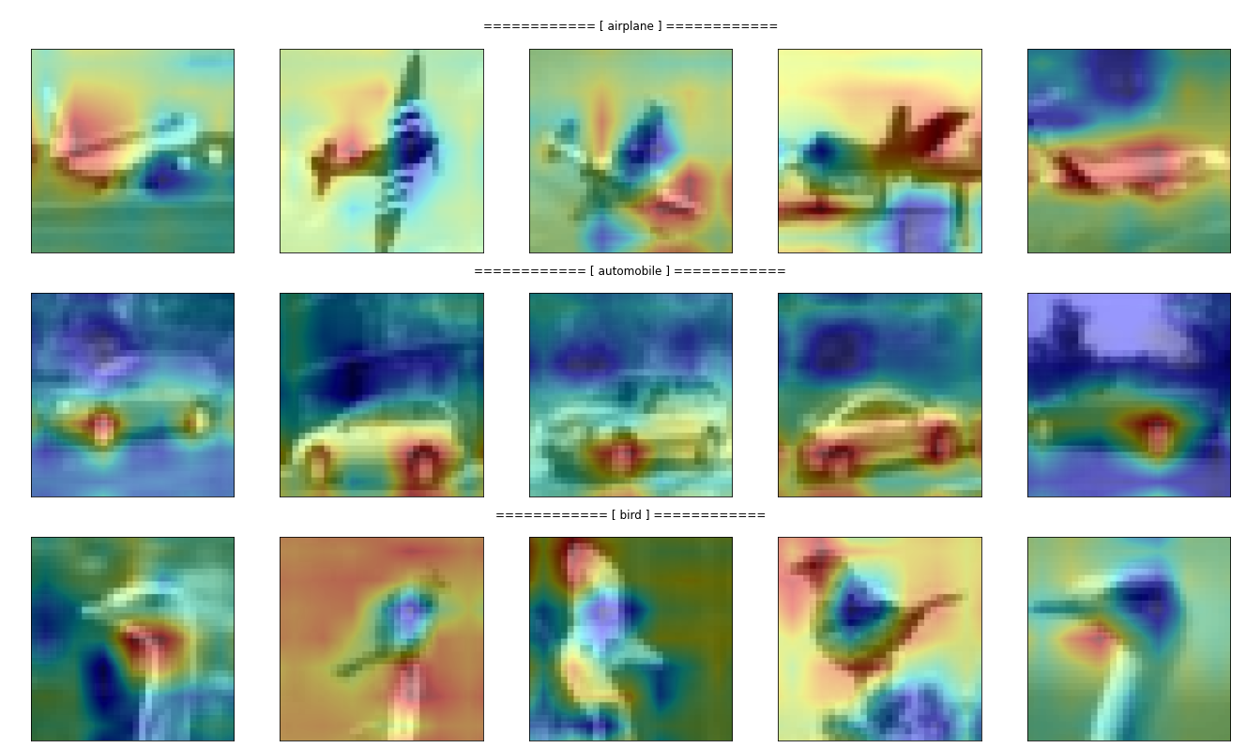
Expected
Result

Slide 42
You can check the full version of today’s .ipynb at https://git.io/aibd-cnn-full

Slide 43
Early Stopping
Just see it and code

Slide 44
Overfitting problem
When the model is too fit to the training dataset so when the performance for non-training data degrades, we call it “overfitted”.
So how can we prevent it? One way is “early stopping”.

Slide 45
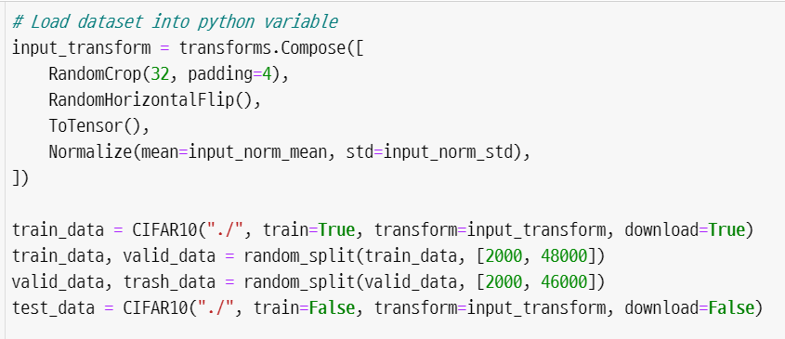
Earlystopping
Code
https://git.io/aibd-early-stop
Just for testing purpose

Slide 46
Earlystopping
Earlystopping can be done with two mechanism.
Wait for “patience” times of no validation loss decreasing.
If the era of no validation loss decreasing continues for “patience” times, then stop the training.
After stopping the training, set the parameters of network as its best parameter (who shown the lowest validation loss).

Slide 47
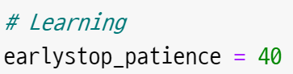
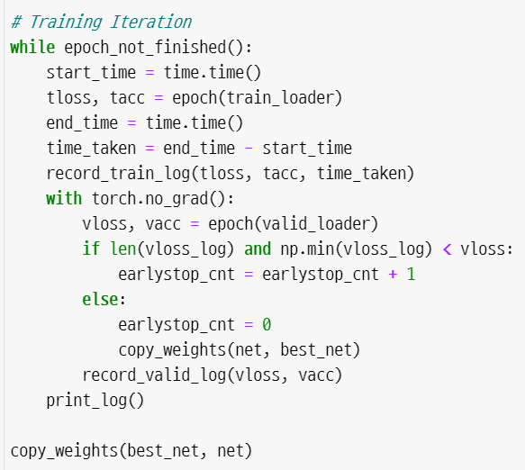
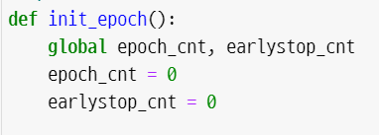
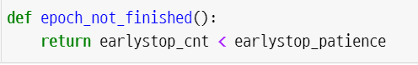
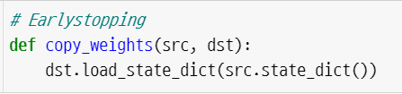
Earlystopping
Earlystopping can be done with two mechanism.

Slide 48
Earlystopping
You can get two advantages from earlystopping
You don’t have to wait for a long time for meaningless training.
You can prevent overfitting.
But sometimes earlystopped model has a poor performance than more-trained model.
So, just use earlystopping when you taking aim about the appropriate epoch count.

